Slide 1
<DATA STRUCTURES AND ALGORITHM>

Slide 2
VI. STACKS

Slide 3
STACKS
A stack is an Abstract Data Type (ADT), used for storing data (similar to Linked Lists). In a stack, the order in which the data arrives is important.
A stack is an ordered list in which insertion and deletion are done at one end, called top. The last element inserted is the first one to be deleted. Hence, it is called the Last in First out (LIFO) or First in Last out (FILO) list.

Slide 4
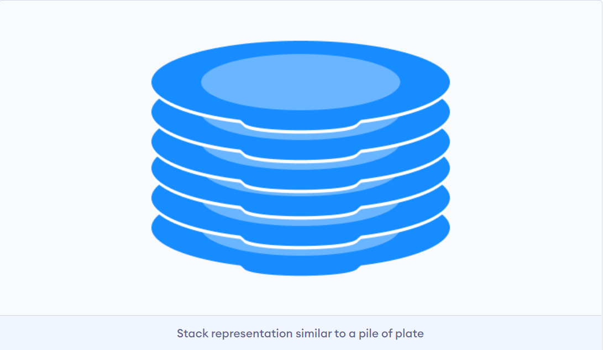
EXAMPLE OF STACKS
A pile of plates in a cafeteria is a good example of a stack. The plates are added to the stack as they are cleaned and they are placed on the top. When a plate, is required it is taken from the top of the stack. The first plate placed on the stack is the last one to be used.

Slide 5
MAINLY OPERATIONS ON STACKS
Special names are given to the two changes that can be made to a stack. When an element is inserted in a stack, the concept is called push, and when an element is removed from the stack, the concept is called pop. Trying to pop out an empty stack is called underflow and trying to push an element in a full stack is called overflow.

Slide 6
MAINLY OPERATIONS ON STACKS
Push: Adds an item in the stack. If the stack is full, then it is said to be an Overflow condition.
Pop: Removes an item from the stack. The items are popped in the reversed order in which they are pushed. If the stack is empty, then it is said to be an Underflow condition.
Peek or Top: Returns the top element of the stack.
isEmpty: Returns true if the stack is empty, else false.
IsFull: Check if the stack is full

Slide 7
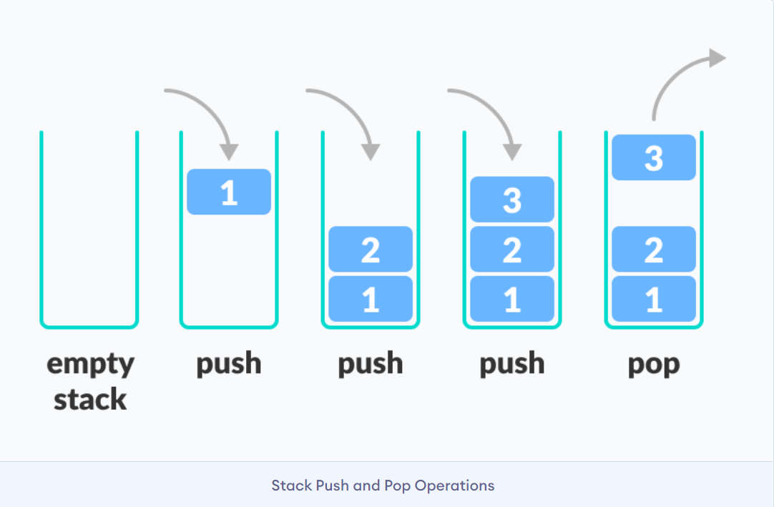
MAINLY OPERATIONS ON STACKS

Slide 8
OPERATIONS ON STACK
The operations work as follows:
A pointer called TOP is used to keep track of the top element in the stack.
When initializing the stack, we set its value to -1 so that we can check if the stack is empty by comparing TOP == -1.
On pushing an element, we increase the value of TOP and place the new element in the position pointed to by TOP.
On popping an element, we return the element pointed to by TOP and reduce its value.
Before pushing, we check if the stack is already full
Before popping, we check if the stack is already empty

Slide 9
TIME COMPLEXITIES OF OPERATIONS ON STACKS
push(), pop(), isEmpty(), isFull() and peek() all take O(1) time. We do not run any loop in any of these operations.

Slide 10
APPLICATIONS OF STACK
Balancing of symbols: Check for Balanced Brackets in an expression
Implementing function calls
In browsers: The back button in a browser saves all the URLs you have visited previously in a stack. Each time you visit a new page, it is added on top of the stack. When you press the back button, the current URL is removed from the stack, and the previous URL is accessed.
Undo sequence in a text editor

Slide 11
isfull()
// Check if the stack is full
int isfull(st *s) {
if (s->top == MAX - 1)
return 1;
else
return 0;
}

Slide 12
isempty()
// Check if the stack is empty
int isempty(st *s) {
if (s->top == -1)
return 1;
else
return 0;
}

Slide 13
PUSH
Step 1 − Checks if the stack is full.
Step 2 − If the stack is full, produces an error and exit.
Step 3 − If the stack is not full, increments top to point next empty space.
Step 4 − Adds data element to the stack location, where top is pointing.
Step 5 − Returns success.

Slide 14
PUSH
// Add elements into stack
void push(st *s, int newitem) {
if (isfull(s)) {
printf("STACK FULL");
} else {
s->top++;
s->items[s->top] = newitem;
}
}

Slide 15
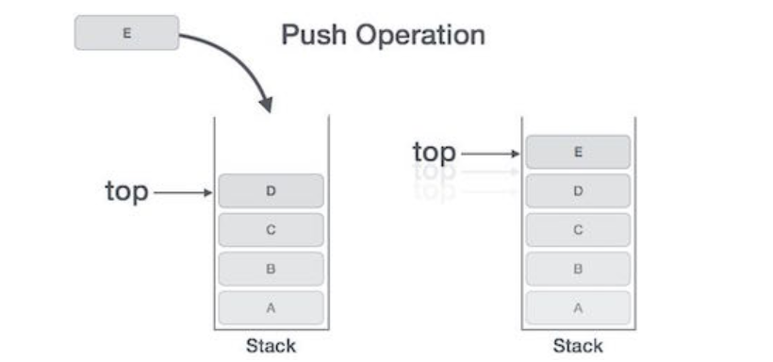
PUSH

Slide 16
POP
Step 1 − Checks if the stack is empty.
Step 2 − If the stack is empty, produces an error and exit.
Step 3 − If the stack is not empty, accesses the data element at which top is pointing.
Step 4 − Decreases the value of top by 1.
Step 5 − Returns success.

Slide 17
POP
// Remove element from stack
void pop(st *s) {
if (isempty(s)) {
printf("\n STACK EMPTY \n");
} else {
printf("Item popped= %d", s->items[s->top]);
s->top--;
}
}

Slide 18
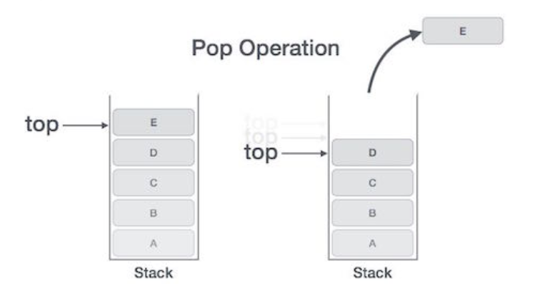
POP

Slide 19
IMPLEMENTATION OF STACK
There are two ways to implement a stack:
Using array
Using linked list

Slide 20
IMPLEMENTATION OF STACK
stack using array(stackarray.c)
stack using linked list(stacklinkedlist.c)

Slide 21
REFERENCES
https://www.geeksforgeeks.org/
Data Structures And Algorithms Made Easy: Data Structures And Algorithmic Puzzles by Narasimha Karumanchi

